Slide 1
动态可搜索加密模型的优化与应用
指导老师：毛睿、王瑾璠
报告人：刘政
Notes:
各位老师下午好，我今天要讲的内容主题是动态可搜索加密模型的优化与应用

Slide 2
Contents
01 Background
02 Related Work
03 Research Content
04 Completed Work
05 Experiment and Conclusion
06 Schedule

Slide 3
Part One
Background

Slide 4
01
Background
Cloud storage services widely used, attention at data security.
Encryption before upload, server can’t search ciphertext online
A efficient search algorithm reducing the computation cost and the bandwidth of network
How to design a search method on ciphertext with high performance.
Notes:
随着网络技术的发展，云存储已经被普遍使用
因此明文状态的数据容易黑客窃取或者被服务端收集
然而加密上传的文件又面临着用户难以借助服务端对数据内容进行检索

Slide 5
Part Two
Related work

Slide 6
02
Related work
Searchable encryption is a cryptographic system which offer secure search functions over encrypted data.
Searchable Encryption
Symmetric Searchable Encryption
Advantage: ①less computation ②Suitable for large data volume
Asymmetric Searchable Encryption
Advantage:①Even in unsafe channels ②More flexible in searching
Considering the efficiency of query and the large amount of data, we mainly study symmetric searchable encryption.
Notes:
接下来我们讲述一下关于在密文检索上的相关工作。首先可搜索加密技术是一项可以在加密数据上检索的安全系统。目前主要有两种方案，第一种是基于对称加密的可搜索加密模型，领挖一种是基于非对称的可搜索加密模型。基于对称加密的可搜索加密模型加密速度快计算量小，适合用在大数据的情况。而非对称可搜索加密模型优点在于可以运行在不安全环境，查询语句也会更加灵活。考虑到数据量大、低延迟的应用场景我们主要针对对称可搜索加密模型做了研究

Slide 7
02
Related work
2003
Goh
Bloom filter
2006
Curtmola
Adaptive security
2012
Kamara
DSSE Model
2017
Cheng Guo
DMPR Model
2002
Song
First Model
2005
Chang Yancheng
Data Dictionary
2010
Chase
Structure Data encryption
2014
Hahn
New DSSE
Notes:
接下来是围绕可搜索加密模型的一系列研究工作。2002年 song等人首先提出了可搜索加密方案，后续Goh借助布隆过滤器对原有方案进行优化但是这种设计方案会引入误报情况。2005年，Chang Yancheng提出了针对单个文件建立数据字典的方案，实现了精确查询。之后Curtmola针对可搜索加密模型的安全性方面提出了适应性安全和非适应性安全并提出了一个适应性安全的对称可搜索加密模型。2010年Chase首次研究了结构化数据的可搜索加密。2012年Kamara首次提出了动态可搜索加密模型（DSSE），该模型不仅支持关键词的检索还允许在线增加或者删除文件中的关键词。2014年Hahn提出了一种新的DSSE模型，该方案在检索和更新的过程中不断更新索引表。2017 年Cheng guo在DSSE模型中引入关键词评分排序确定返回文件的先后顺序

Slide 8
Part Three
Research content

Slide 9
03
Research content
Motivation:
Optimization of searchable encryption models
Optimize the search algorithm for searchable encryption?
The value in real environment
Apply searchable encryption into reality.
Objects:
Improve the efficiency of search process in DSSE model with dynamic accumulator.
Propose a secure cloud storage system with searchable encryption.
Notes:
因此我们的创新点主要从两个方面出发，第一个是如何对现有可搜索加密模型中的查询过程进行改进。此外，可搜索加密技术的提出是为了解决服务端无法在密文上检索的弊端，我们能否提出一个新的云存储系统架构来模拟可搜索加密技术在现实中的应用？
结合上述内容，我们工作主要从两个方面出发，一个是引入密码学中的累加器来改进现有可搜索加密模型中的查询过程，另外一方面我们提出一个具有可搜索加密功能的新型云存储系统

Slide 10
Part Four
Completed Work

Slide 11
04
Completed Work
Improving search process
Introduce the dynamic accumulator
A cryptographic accumulator is a one way membership function. It answers a query as to whether a potential candidate is a member of a set without revealing the individual members of the set.
Dynamic accumulators can dynamically add and remove elements on existing accumulators
New idea
In the data dictionary, aggregate all keywords of a file to a accumulated value.
Compare the accumulated values of the keywords in a file during the query process.
Notes:
一个密码学上的累加器是一个单项隶属函数。对于指定的查询可以判断该成员是否在集合内，在判断的过程不会暴露集合内部其他成员。
动态累加器是指在普通累加器基础上可以动态的增加和删除集合内部元素。
综上所述动态累加器的特点是可以动态的增加或者减少集合内成员，第二点就是证明过程不会暴露集合内部成员

Slide 12
04
Completed Work
The way we improve the search process
Create a new index table in the DSSE model to speed up the discovery process
Fast get the location of the file
Each file only needs to be compared only once
Reduce the number of compared process during searching
Notes:
因此我们提出在现有可搜索加密模型建立新的索引结构，新的索引结构在理论上有以下优点：1.快速定位关键词所在的文件 2.每个文件在查找过程中只需要比对一次就确定是否包含关键词 3.降低了大量的哈希和加密运算

Slide 13
04
Completed Work
Basic file-keyword index
Inverted Index
file
r₁|F_{trap}(r₁) | r₂|F_{trap}(r₂) | r₃|F_{trap}(r₃) | r₅|F_{trap}(r₅) | r₆|F_{trap}(r₆)
………
.
.
.
.
Trapdoor
file 1 | file 2 | file 3 | file 4 | file 5
………
.
.
.
.
Notes:
上面两幅图是这两个索引的结构，其中数据字典索引以key-value形式存储，key一般为文件的标识符，value内容为基于关键词映射的hash值再连接上基于陷门为密钥的关键词hash加密后的值。反向索引也是一个key-value结构，其中key存储了关键词的陷门，value则是包含该陷门文件的标识符

Slide 14
02
Completed Work
Traditional Search Method(2014 2017)
Traversing indexes based on trapdoor
①Inverted Index hit
Trapdoor | file 1 | file 2 | file 3
………
Trapdoor
.
.
.
.
File1 | File2 | File3 | File4 | file
Notes:
经典的查询过程分为两种情况，第一种是反向索引命中的情况，另外一种是反向索引没有命中的情况。首先第一种情况是查询过程中在反向索引找到了陷门对应的信息，因此直接返回该陷门对应记录中存储的文件ID列表

Slide 15
04
Completed Work
②Inverted index not hit
File identifier | r₁|F_{trap}(r₁) | r₂|F_{trap}(r₂) | r₃|F_{trap}(r₃)
…
search
Trapdoor
return
.
.
.
Trapdoor, File id(list)
add
Trapdoor | file 1 | file 2 | file 3
…
…
.
.
.
File1 | File2 | File3 | File4 | file
Notes:
第二种情况是在反向索引没有命中的情况下，只能够去数据字典中遍历每个文件中的记录并进行hash和加密运算确认该文件是否包含陷门信息，查找过程中会记录包含该陷门的文件列表，之后会将该陷门对应的文件ID信息插入到反向索引中并返回给客户端

Slide 16
04
Completed Work
1. Calculate the accumulated value
Keyword list of a file
……
AC
Accumulator
Word1 | Word2 | Word3 | Word4
……
C₁ | C₂ | C₃ | C₄
2. Build accumulation index
File identifier | Accumulator value
ID₁ | AC₁
ID₂ | AC₂
.
.
.
.
.
.
Notes:
新索引建立过程分为两步骤，第一步是借助累加器将单个文件中全部关键词累加到一个值，同时对于每个关键词生成一个证据用于后续的存在证明。下一步就是按照文件标识符-文件累加值的形式存储这些数值

Slide 17
04
Completed Work
Inverted Index
New search algorithm
………
Trapdoor | file 1 | file 2 | file 3
①Inverted Index Hit
.
.
.
Trapdoor, C
………
File1 | File2 | File3 | File4 | file
Notes:
接下里我们关注在引入新索引后的查询过程，我们查询过程中也采用了了反向索引的结构设计。第一种情况就是查找过程中反向索引表命中，这种情况下直接将反向索引记录的文件ID信息直接返回

Slide 18
04
File identifier | Accumulator value
ID₁ | AC₁
ID₂ | AC₂
ID₃ | AC₃
Completed Work
②Inverted index not hit
search
return
.
.
.
Trapdoor, C
Data dictionary
File identifier | r₁|F_{trap}(r₁) | r₂|F_{trap}(r₂) | r₃|F_{trap}(r₃)
…
search
Trapdoor, ID(list)
return
.
.
.
Inverted Index
Trapdoor, File id(list)
add
Trapdoor | file 1 | file 2 | file 3
…
…
.
.
.
File1 | File2 | File3 | File4 | file
Notes:
第二种情况是反向索引没有命中，这种情况下服务端首先查询新索引，借助自身携带的证据和陷门确认关键词在文件列表中的位置，借助新索引返回的文件标识符去数据字典中查询该文件对应的具体关键词信息，确认关键词的具体位置。最后将查询到的文件列表集合以及自身陷门插入到反向索引中，然后返回相应的文件列表。

Slide 19
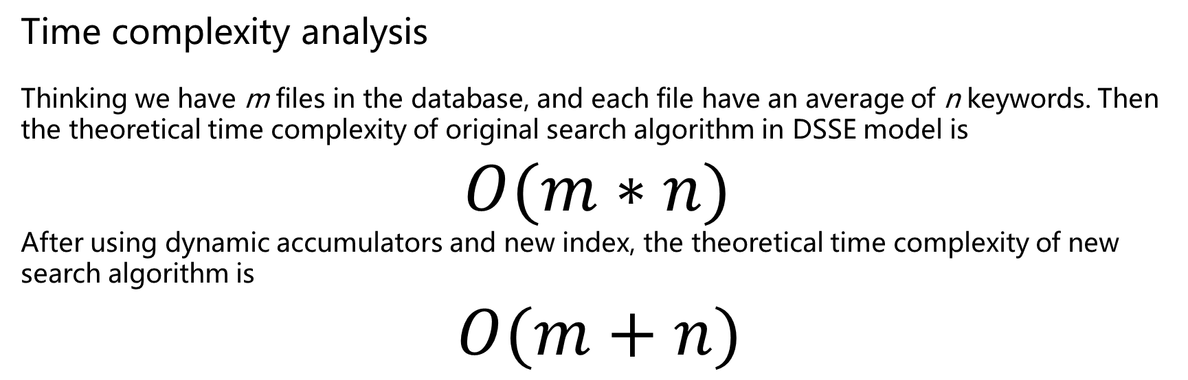
04
Completed Work
Time complexity analysis
Thinking we have m files in the database, and each file have an average of n keywords. Then the theoretical time complexity of original search algorithm in DSSE model is
$O(m∗n)$
After using dynamic accumulators and new index, the theoretical time complexity of new search algorithm is
$$O(m+n)$$

Slide 20
04
Completed Work
Propose a new secure cloud storage system
The definition the security of a cloud storage system
In order to define a secure cloud storage system, we must analyze threat models in existing cloud storage systems
Untrusted server
Untrusted network channel
A secure cloud storage system should have the following properties
Data should be encrypted by the user before stored in the server.
Encrypt the data stream when transmitting.
Notes:
第三个问题就是如何定义一个安全的云存储系统，这里我们主要分析现有云存储系统的威胁模型。
现有云存储系统中，数据主要会存在于三个地方，分别是用户、服务端和网络信道。这里我们解决的安全问题主要聚焦在服务端和网络信道上。
因此为了确保用户存储在服务端的安全，用户应先将数据进行加密然后再上传
在应对复杂不可信的网络信道方面，我们需要对传输内容进行加密防止他人从网络信道中截取我们的数据

Slide 21
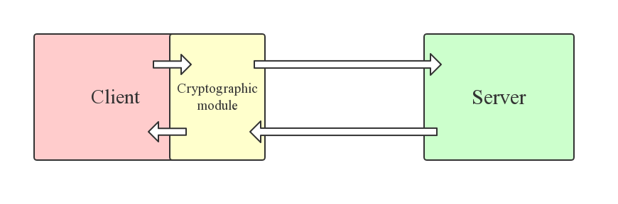
04
Completed Work
Design for a secure cloud storage system with searchable encryption
New cloud storage system
Taking into account the above requirements, we make the following design
Data is encrypted before uploaded, and decrypted after downloading

Slide 22
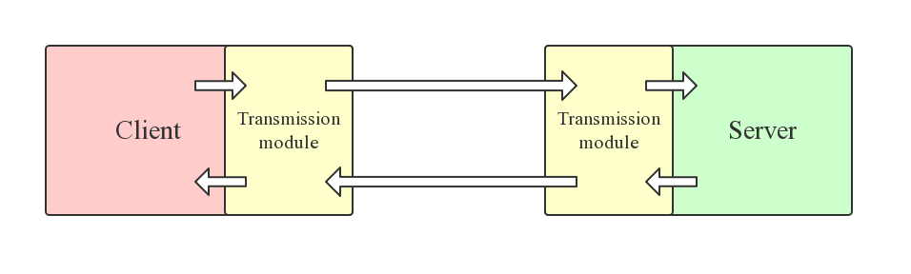
04
Completed Work
Design new transmission modules to ensure reliable and safe transmission process
Based on UDP
Flexible in complex network
Flow control
Encryption and Verification

Slide 23
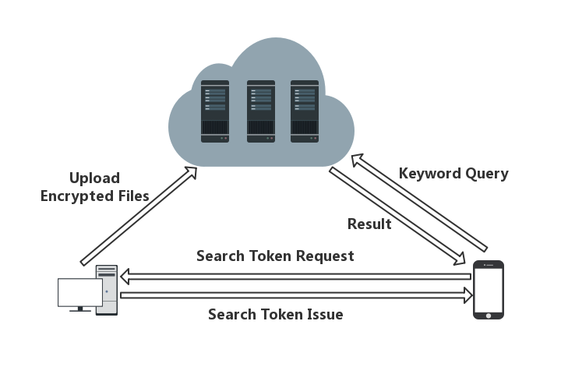
04
Completed Work
Support dynamic searchable encryption

Slide 24
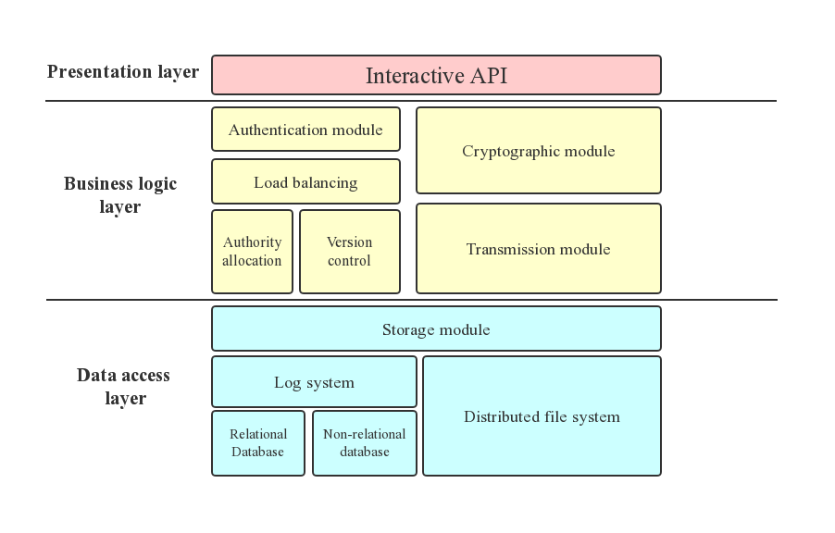
04
Completed Work
System prototype design

Slide 25
Part Five
Experiment

Slide 26
05
Experiment
Environment and configuration
配置信息 | 操作系统 | 数量 | 服务器/客户端
CPU：Intel i7-8700@3.2GHz 内存：16GB DDR4 显卡：NVDIA GeForce GTX 1060-3G | Windows10 professional | 2 | 服务器
CPU：Intel i5-8250U@1.60GHz 内存：8GB DDR4 显卡：NVDIA GeForce MX150 | Windows10 professional | 1 | 服务器
CPU：AMD Ryzen 1700@3.0GHz 内存：16GB DDR4 显卡：NVDIA GeForce GTX 1050ti | Windows10 professional | 1 | 客户端

Slide 27
05
Experiment
In the simulation experiments, we used three different algorithms. They are data dictionary, inverted index and new algorithm based on dynamic accumulator.
In this simulation experiment, we assume that every file contains five keywords, we do experiment with different number of files or queries , then we measure the cost time of when all queries completed.

Slide 28
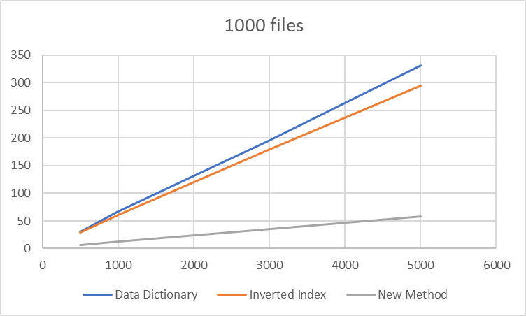
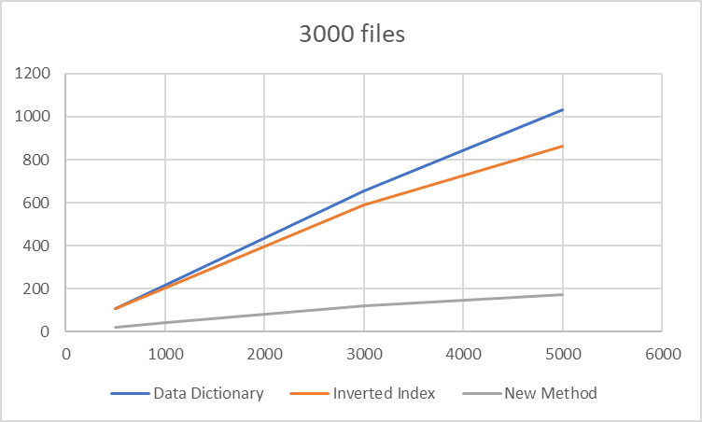

05
Experiment
In the following table,
the X-axis means different numbers of queries we used during search tests,
the Y-axis means the cost time(s) during search,
The head means the number of files.

Slide 29
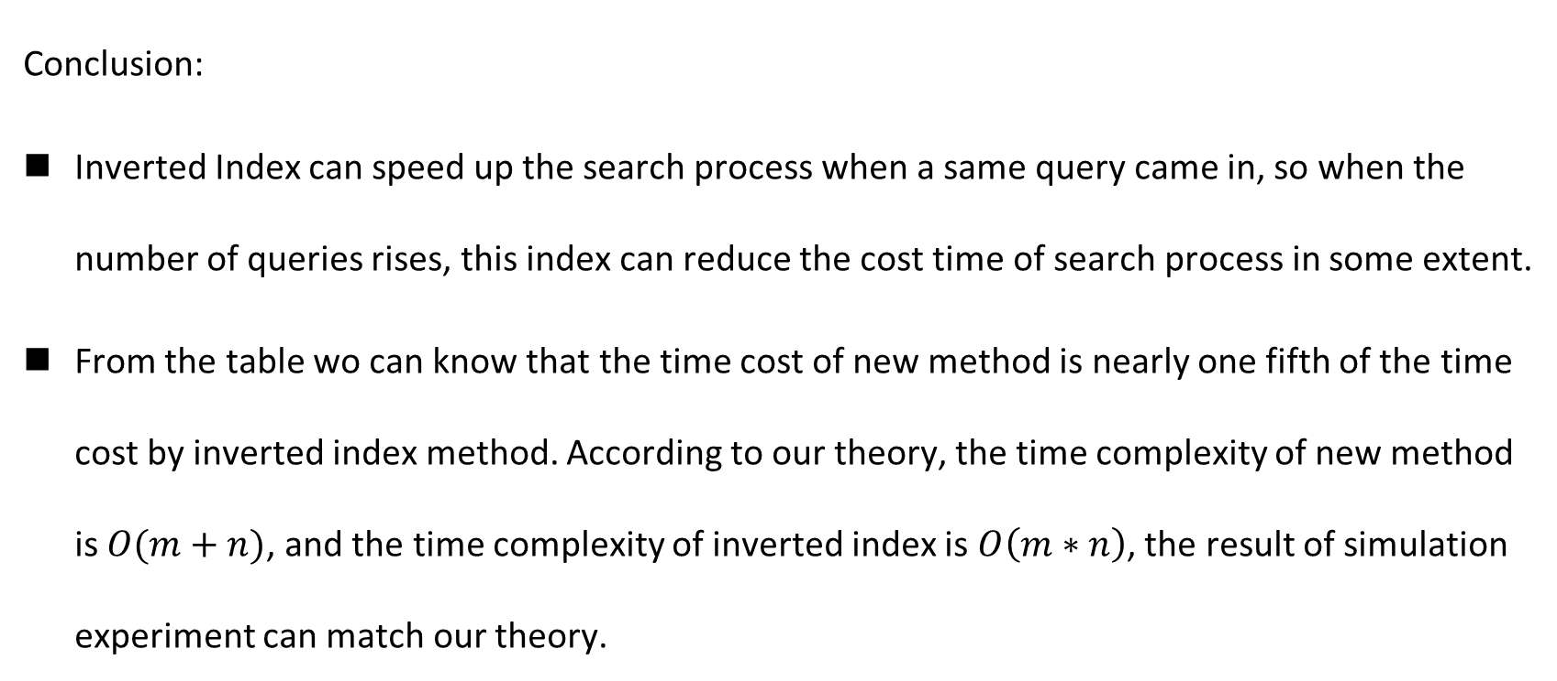
05
Experiment
Conclusion:
Inverted Index can speed up the search process when a same query came in, so when the number of queries rises, this index can reduce the cost time of search process in some extent.
From the table wo can know that the time cost of new method is nearly one fifth of the time cost by inverted index method. According to our theory, the time complexity of new method is $O(m+n)$, and the time complexity of inverted index is $O\left(m∗n\right)$, the result of simulation experiment can match our theory.

Slide 30
Part Six
Schedule

Slide 31
05
Schedule
Completed works
Survey on searchable encryption
Survey on dynamic accumulator
Propose a new search method, more efficient in searchable encryption during search.
New design for system framework and modules
Implementation for system modules
Notes:
目前已经做得工作有
1.关于可搜索加密技术的文献调研
2.针对动态累加器的文献调研
3.基于新的索引表提出一个新的查询方法
4.新系统的设计与模块实现

Slide 32
05
Schedule
Schedule
2019.3-2019.6 Research on searchable encryption model and dynamic accumulator,
Implement related modules of new system.
2019.7-2019.8 Implement new search algorithm.
2019.8-2019.9 Implement the storage module of system, new cloud system integration test
2019.10-2019.12 Improve the performance of system, comparing the new system with similar work, summarizing the advantages and disadvantages of the system.
2020.1-2020.2 Complete all the work of the new system, test the efficiency of searchable encryption and other performance indicators
Notes:
目前的工作计划安排是3月到六月是在做关于可搜索加密技术的调研工作，实现一些关于系统的模块
7-8月会将新的查询算法进行实现并测试
8-9月会将整个新的云存储系统实现并进行集成测试
10-12月会对新系统进行改进，比较相似文献中他人的工作，总结分析新系统的优缺点
2020.1-2020.2完成新系统的全部工作，测试有关加密搜索功能和其他性能指标

Slide 33
Q&A
Notes:
接下来是提问环节

